Slide 1


Augmenting NMT Architecture
with Linguistic Features
Part of the EAMT 2024 Tutorial
Linguistically Motivated Neural Machine Translation
Hour Kaing
https://hour.github.io

Slide 2
Agenda
Linguistic features, tools and datasets
Augmented input feature NMT
Tree encoder
Syntax-aware representation
Syntax-aware self-attention

Slide 3
Agenda
Linguistic features, tools and datasets
Augmented input feature NMT
Tree encoder
Syntax-aware representation
Syntax-aware self-attention

Slide 4
Linguistic Features
Lemma
A lemma is the canonical form, or dictionary form of a set of word forms. [Wikipedia]
For examples
In English, break, breaks, broke, broken and breaking have the same lemma as break.
In French, aller, vais, va, allait, and ira have the same lemma as aller (go).
Notes:
This concept is fundamental in linguistics and computational linguistics.
It helps in reducing different forms of a word to a common base form.
By doing this, it is easier to analyze and understand a sentence, especially for inflectional languages.
For examples in English, these words all refer back to the same base form or lemma, which is "break.”
Also, for French, these words all refer back to the base form "aller” that means ”go”.

Slide 5
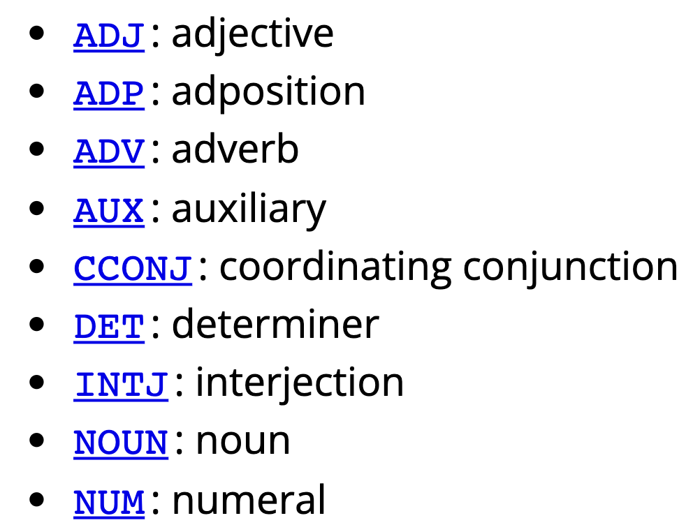
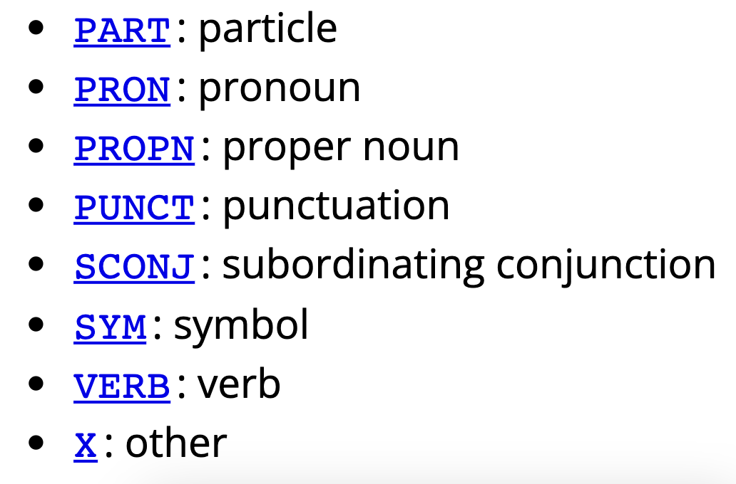
Linguistic Features
Part-Of-Speech (POS)
A POS is a word class or grammatical category of words that have similar grammatical properties. [Wikipedia]
For examples
Noun : home, house, and television.
Verb : walk, happen, or to be.
Universal POS tags used by the Universal Dependency project.
Notes:
A POS is a grammatical category given to words that share similar grammatical properties.
These categories let us know the role of a word play in a sentence.
It can influence how we interpret the meaning of a word and its relationship with other words.
Two common features that is noun and verb
- Nouns typically represent people, places, things, or concepts. For example, words like 'home,' 'house,' and 'television' fall into this category.
- Verbs describe actions, occurrences, or states of being. Examples include 'walk,' 'happen,' and 'to be.'

Slide 6
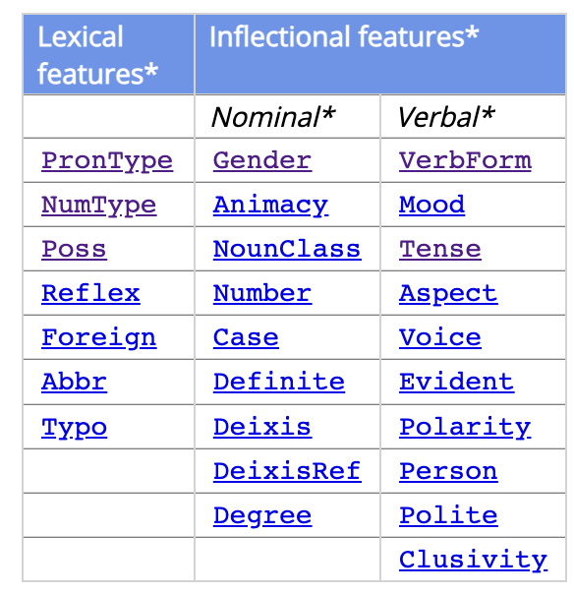
Linguistic Features
More specific grammatical properties or morphological features
Pronominal type (PronType)
Personal/possessive pronoun (Prs) : he, she, his, her, …
Article (Art) : a, an, the
Tense (Tense)
Past (Past) : went, gone, …
Present/non-past tense (Pre) : goes, going, …
From Universal Dependency
Notes:
Deeper into more specific grammatical properties or morphological features.
These features help us further understand word based on their forms functions in a sentence.
In another word, these provide additional details about words that go beyond basic POS categories.
A few examples of features:
- Pronominal type to be pronoun or article.
- Personal/possessive pronoun indicate possession or replace nouns in sentences
– Article define a noun as specific or unspecific such as the (specific), a, an (unspecific).
- Tense to be past or present

Slide 7
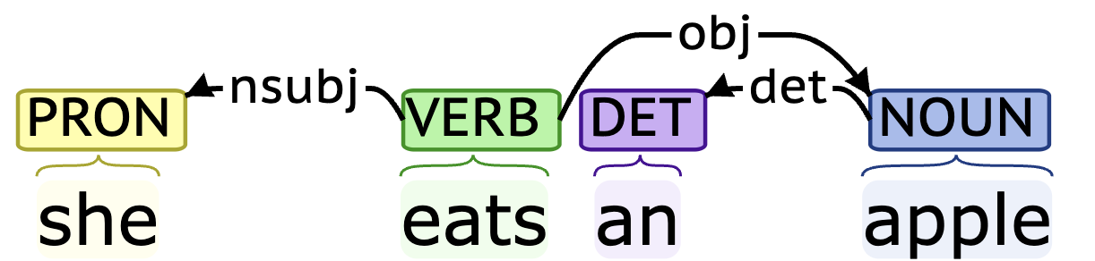
Linguistic Features
Dependency grammars
The grammars are based on the dependency relation between words.
A dependency is a directed link from a head word to a dependent word.
2
nsubj
0
root
3
det
2
obj
Example generated by Stanza
Notes:
- The dependency grammars are based on an idea that words in a sentence are connected based on their dependencies and form a network of relationship that represent the sentence structure.
A dependency is a directed link connected from a head word to a dependent word. We can regard it as a parent-child relationship.
For examples, eats is a parent of she and apple. Apple is a parent of an because an modify apple.
- By analyzing these grammar relations, we can gain insights into how different elements of a sentence interact and contribute to its overall meaning.

Slide 8
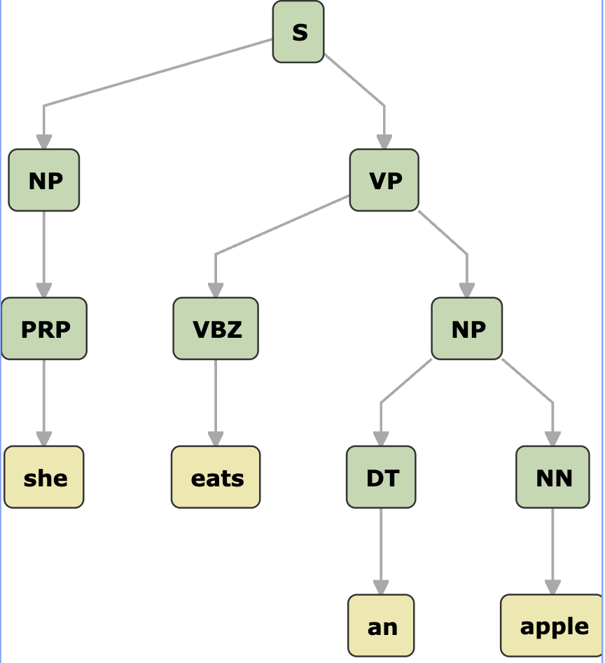
Linguistic Features
Constituency/phrase structure grammars
The grammars are based on the constituency relation between words
A constituent is a word or a group of words that function as a single unit within a hierarchical structure. [Wikipedia]
Constituency is a hypergraph problem
An edge can join any number of vertices
Figure generated by Stanza
Notes:
This is another grammar that is based on a concept of constituency relations.
The focus is on how words group together to form constituents as units.
In this example, eats an apple is a unit of verb phrase. It can be further break down into smaller constituents like eats and an apple.
With this grammar, we gain a clear understanding of its composition and how different parts function together to convey meanings.
In a hypergraph, an edge can join any number of vertices, unlike in a traditional graph where an edge connects only two vertices.

Slide 9
Analysis Tools
Lemma, POS, morphological features, and dependency
Stanza : https://stanfordnlp.github.io/stanza
Support 66 languages
SpaCy : https://spacy.io
Support 75+ languages
UDPipe : https://lindat.mff.cuni.cz/services/udpipe
Support 100+ languages
Notes:
So far, we have seen linguistic features from low to high level, which are crucial to analyze and understand a sentence.
To analyze them, there are tools available for some languages to automatically predict the linguistic features of a given sentence.
For examples, these are three popular tools to analyze Lemma, POS, etc that support up to 100 languages .

Slide 10
Analysis Tools
Constituency parsing tools
Stanza
Support 10 languages
Berkeley parser : https://github.com/nikitakit/self-attentive-parser
Support 11 languages
SuPar : https://github.com/yzhangcs/parser
Support 11 languages
Notes:
These are for constituency grammars but
number of supported languages is fewer, which is around 10 languages by these three popular tools.

Slide 11
Linguistic Datasets
Universal Dependencies : https://universaldependencies.org
Features: lemma, POS, morphological features, dependency.
Contains 200 treebanks in over 100 languages
Consitunecy Treebanks
Penn Treebank : https://catalog.ldc.upenn.edu
English, Chinese, Korean, and Arabic.
SPMRL2013/2014 : https://www.spmrl.org/spmrl2014-sharedtask.html
Arabic, Basque, English, French, German, Hebrew, Hungarian, Korean, Polish, and Swedish
Asian Language Treebank : https://www2.nict.go.jp/astrec-att/member/mutiyama/ALT
English, Japanese, and Myanmar.
Notes:
20 mins

Slide 12
Agenda
Linguistic features, tools and datasets
Augmented input feature NMT
Input features embedding
Multiple and mixed encoder
Syntax distance
Tree encoder
Syntax-aware representation
Syntax-aware self-attention

Slide 13
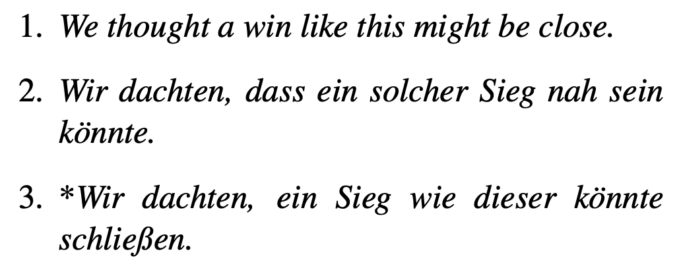
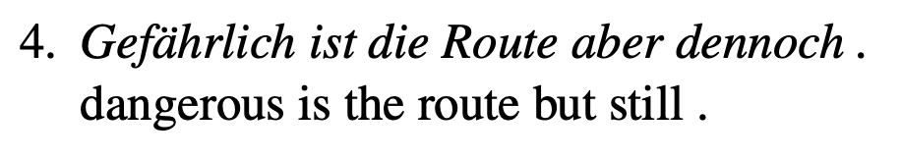
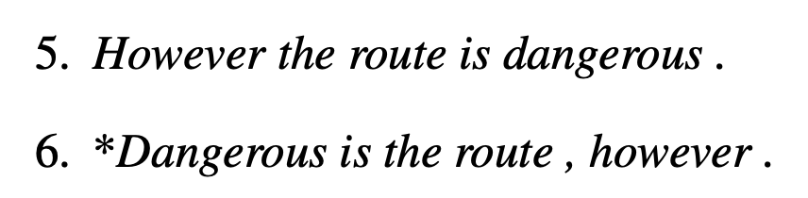
Motivations
Word form ambiguity
Word order discrepancy
adjective
verb
4. in German have a verb-second (V2) order.
But English is generally SVO.
Solution : give a POS tag as a hint to disambiguate the word
that shares the same form across word types.
Solution : give a syntactic annotation as a hint
to guide the model which words to attend
and translate first.
e.g., where is root, nsubj, etc.
Rico Sennrich et al., Linguistic Input Features Improve Neural Machine Translation, 2016
Notes:
For instance, close can be a verb, adjective, or noun, and these different meanings often have distinct translations into other languages.
Example 2) denoted by *, a neural MT system mistranslates close as a verb, and produces the German verb schließen.
Intuitively, providing an annotation of POS could disambiguate the meanings of close.
Second examples is the word order discrepancy.
The MT system retain the original order of words in German, which has a verb-second word order.
But English is generally SVO.
So, provide a dependency relation could be helpful for this.

Slide 14
Other Features
Lemma
Share information between words with the same base form
Morphological features
Like POS tags but with more detail properties
Word boundary or subword tags
Give models clues which symbols to attend to, and when to forget the information
Rico Sennrich et al., Linguistic Input Features Improve Neural Machine Translation, 2016

Slide 15
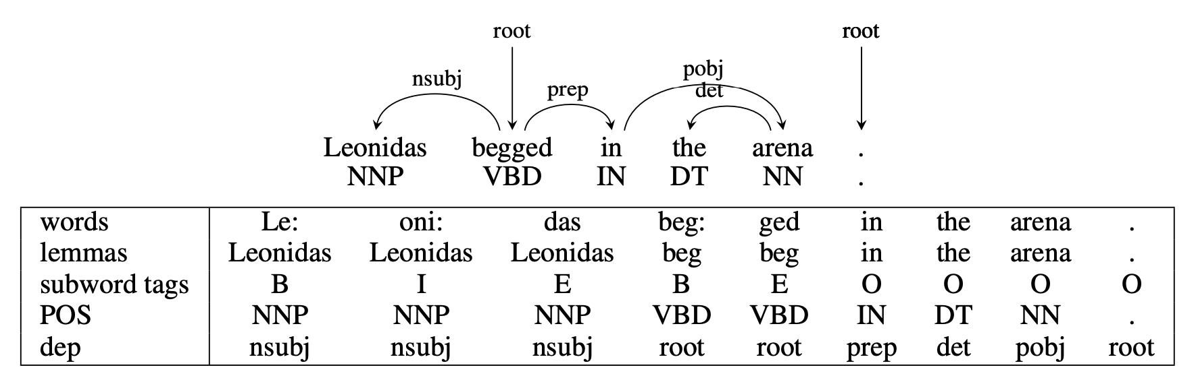
Examples of Features
Rico Sennrich et al., Linguistic Input Features Improve Neural Machine Translation, 2016

Slide 16
How To Integrate Into NMT?
Encoder
Decoder
[e_{tok}, e_{feat}]
Concatenate
[e_{tok}, e_{feat}]
Token Embedding
Feature Embedding
Token Embedding
Feature Embedding
…
Token
Feature
Token
Feature
Rico Sennrich et al., Linguistic Input Features Improve Neural Machine Translation, 2016
Notes:
We hope the model get a hint from the features when it is not confidence to translate the input tokens.
However, analysis tools are not perfect and would predict wrong features for a given sentence or tokens.
MT systems may pay too much attention to the features when translate.

Slide 17
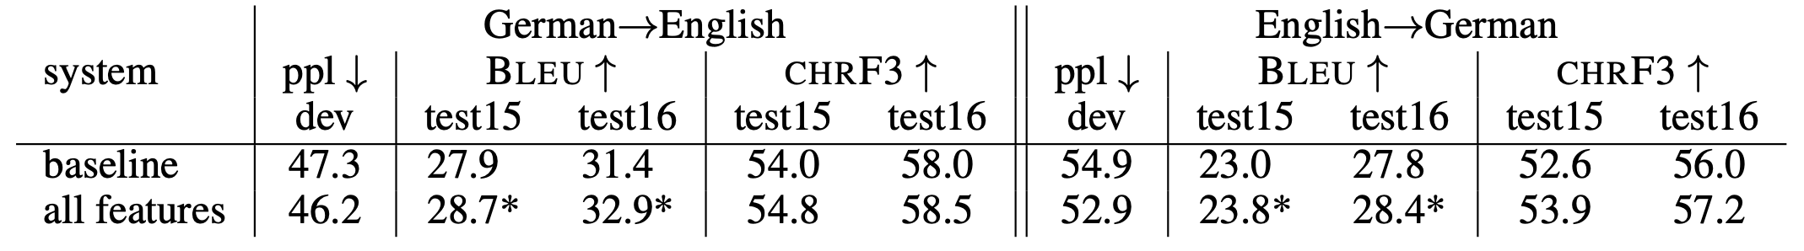
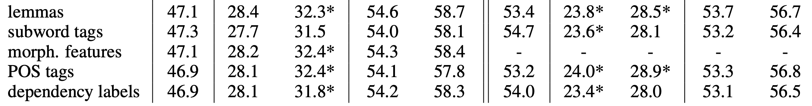
Features Relevance
Some features are more relevant to the translation than the others
Intuition: weighting the features would give better translation
Rico Sennrich et al., Linguistic Input Features Improve Neural Machine Translation, 2016

Slide 18
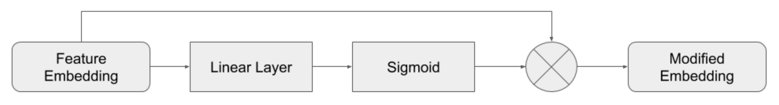
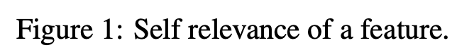
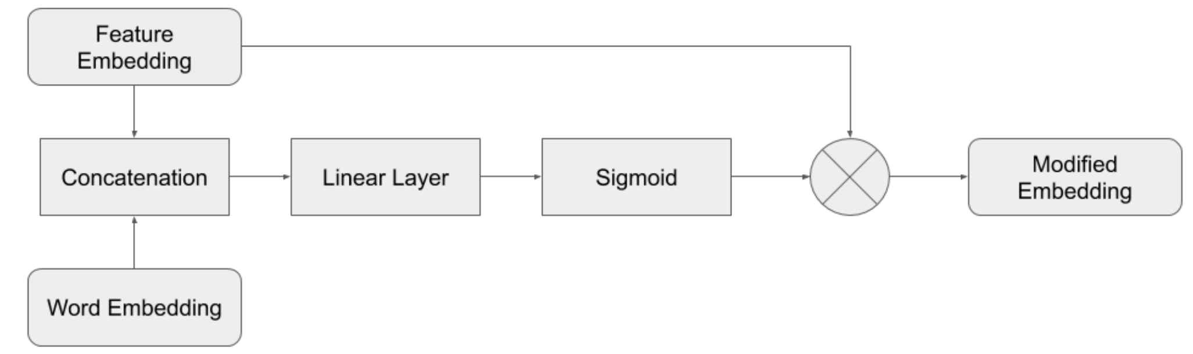
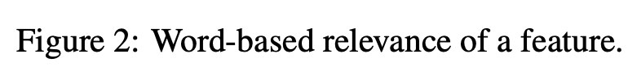
Features Relevance Weighting
Abhisek Chakrabarty, et al., Improving Low-Resource NMT through Relevance Based Linguistic Features Incorporation, 2020
Notes:
So, here, we can train model to weight how features is relevant for translation
by using an additional linear layer and sigmoid function on top of feature embedding.
Or we can weight the feature by considering the context information from the word embedding.
In this first approach, the weight of a feature will always be the same during inference.
In the second one, the weight change with respect to a word.

Slide 19
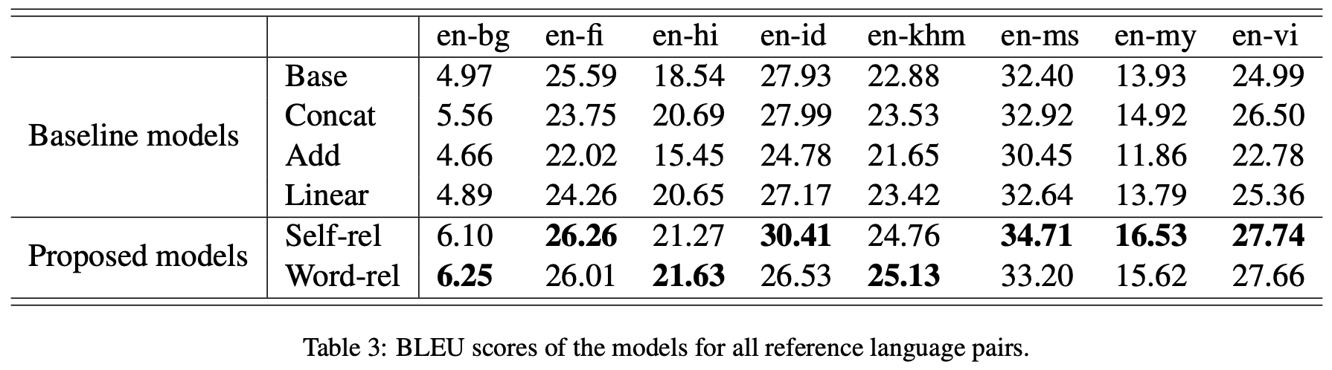
Features Relevance
Extremly low-resource languages
Abhisek Chakrabarty, et al., Improving Low-Resource NMT through Relevance Based Linguistic Features Incorporation, 2020
Notes:
So, here, we can train model to weight how features is relevant for translation
by using an additional linear layer and sigmoid function on top of feature embedding.
Or we can weight the feature by considering the context information from the word embedding.
In this first approach, the weight of a feature will always be the same during inference.
In the second one, the weight change with respect to a word.

Slide 20
Features in Other NMT Settings
Features in pretraining stage of BART [Chakrabarty+22]
Both content tokens/spans and features are masked.
Improvement was observed in an extremely low-resource settings
Features in multilingual settings [Chakrabarty+23]
Language ID and dummy features are important in multilingual setting.
Dummy features
Each sentence have two representation, w/ dummy or w/ linguistic features
Abhisek Chakrabarty, et al., FeatureBART: Feature Based Sequence-to-Sequence Pre-Training for Low-Resource NMT, 2022
Abhisek Chakrabarty, et al., Low-resource Multilingual Neural Translation Using Linguistic Feature-based Relevance Mechanisms, 2023

Slide 21
Grammar Relations for Augmented Input Features
Grammars (dependency or constituency) are relations between two or multiple words instead grammatical properties for individual words.
Approaches to integrate the grammars more effectively
Multiple encoders
Mixed encoder
Transformation to syntactic distance

Slide 22
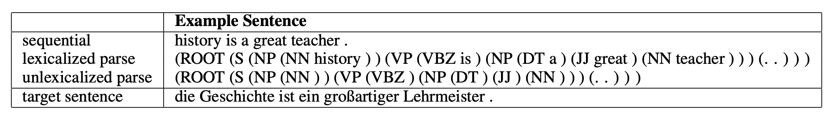
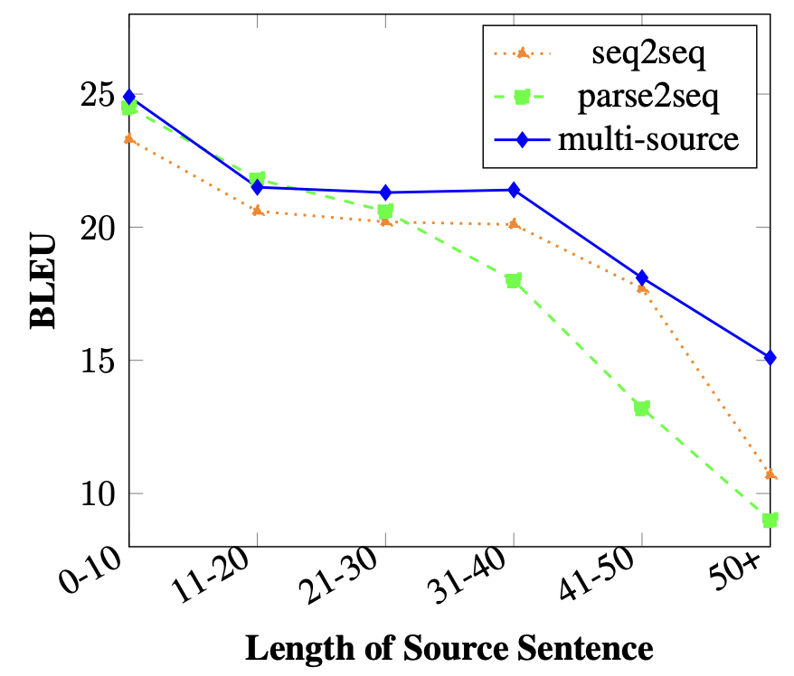
Multiple Encoders
Linearized tree
Multiple-Encoder NMT
Length-agnostic between tree and input
RNN NMT with hierarchical attention
combine
Encoder
Encoder
Decoder
tree
input sent.
output
Anna Currey, et al., Multi-Source Syntactic Neural Machine Translation, 2018

Slide 23
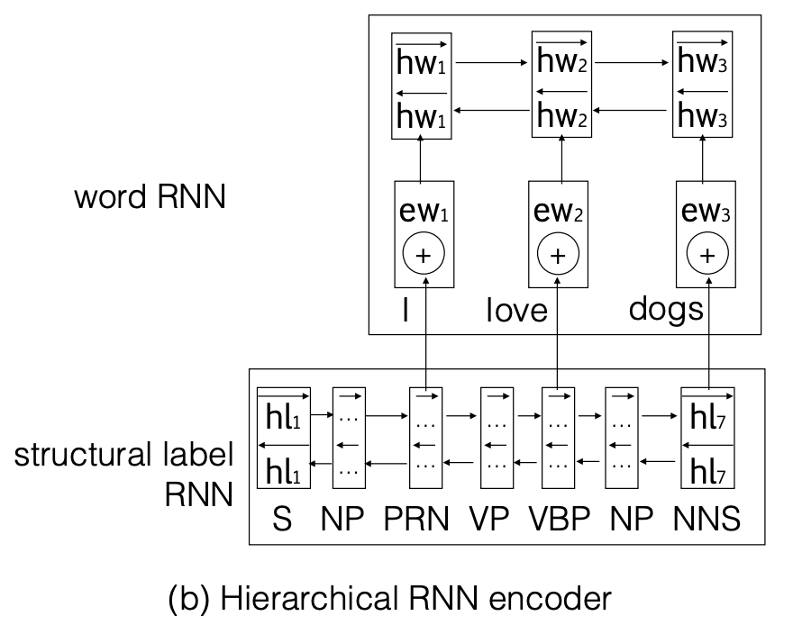
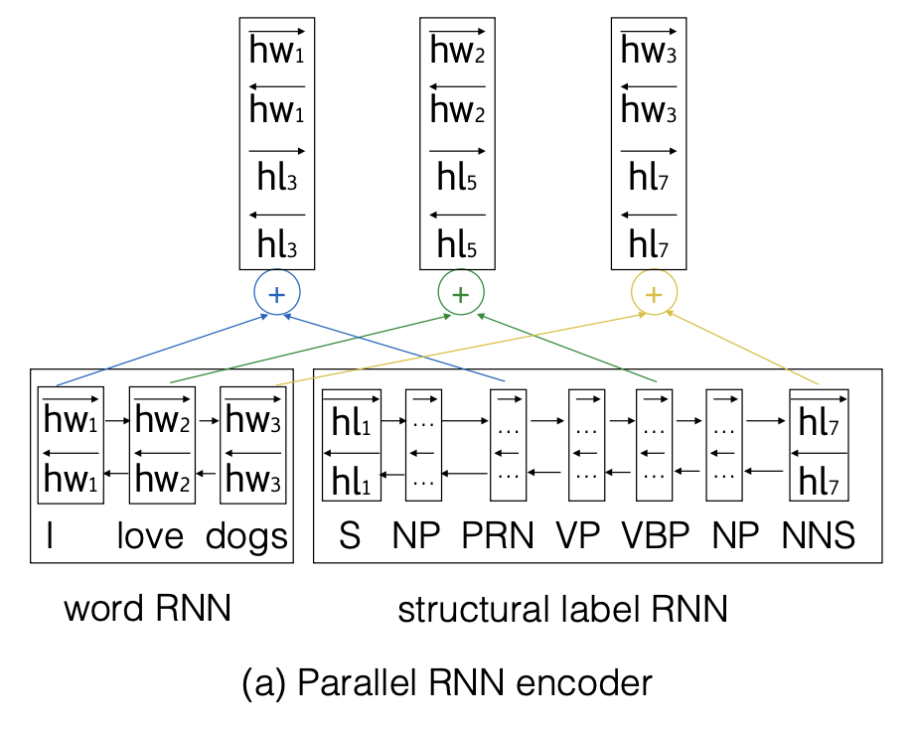
Multiple Encoders
Use only the output vectors of terminal nodes
len(terminal nodes) == len(sentences)
Junhui Li, et al., Modeling Source Syntax for Neural Machine Translation, 2017
Notes:
Another simpler way is to take the encoding output of the structure at the terminal node and combine with that of the sentence.
Then simply concatenate them as a new representation.

Slide 24
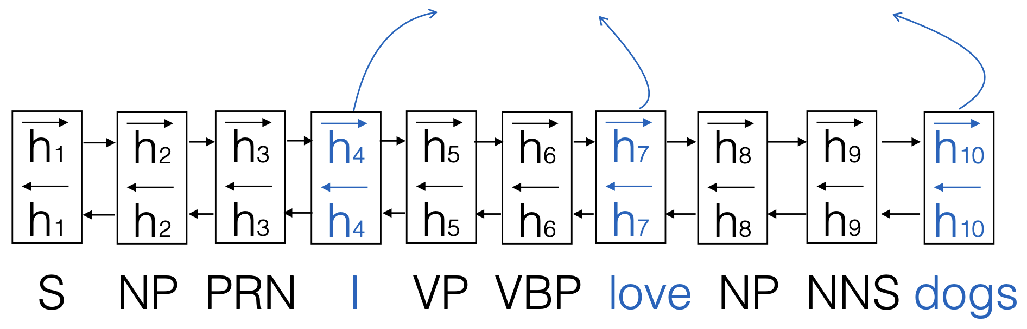
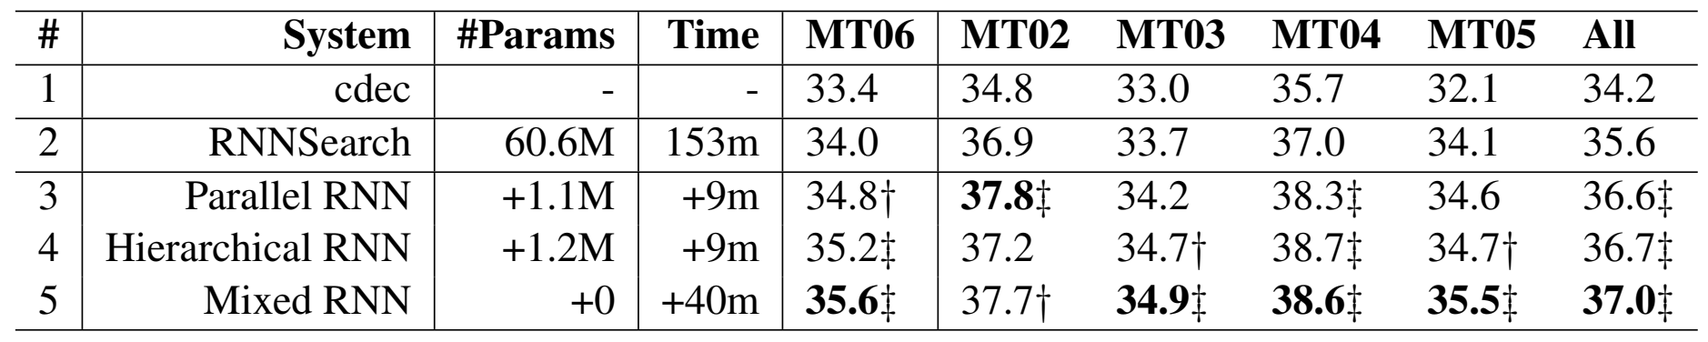
Mixed Encoder
Encode the linear lexicalized tree
Take only output vectors of words for decoding
Mixed RNN Encoder
Junhui Li, et al., Modeling Source Syntax for Neural Machine Translation, 2017

Slide 25
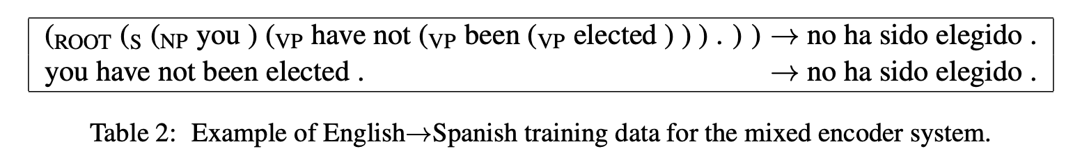
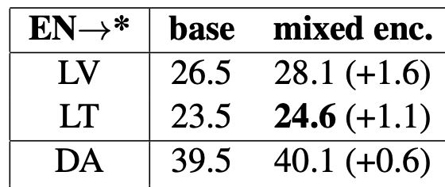
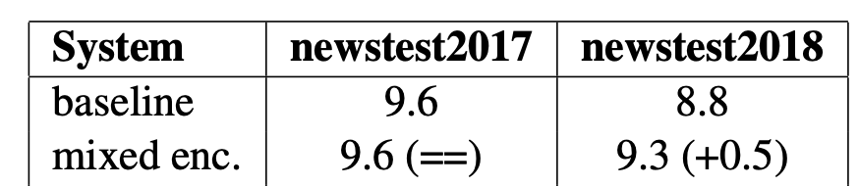
Mixed Encoder
Data augmentation
Combine source parses and sentences
Shuffle so that two-sentence pairs are not seen together during traning
Small scale
Large scale
Anna Currey, et al., Incorporating Source Syntax into Transformer-Based Neural Machine Translation, 2019

Slide 26
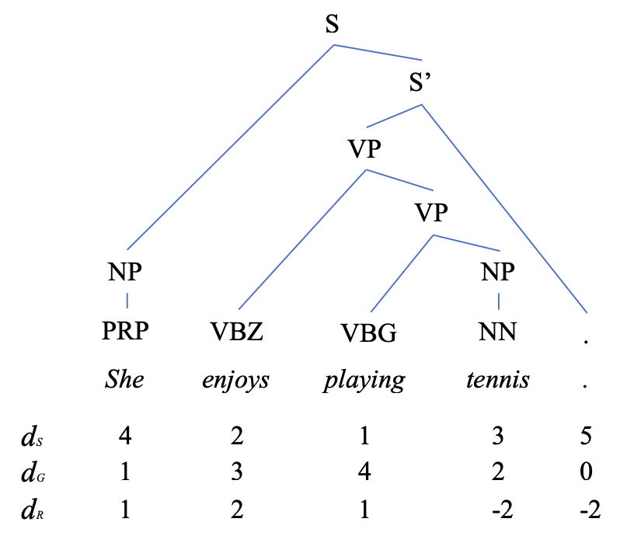
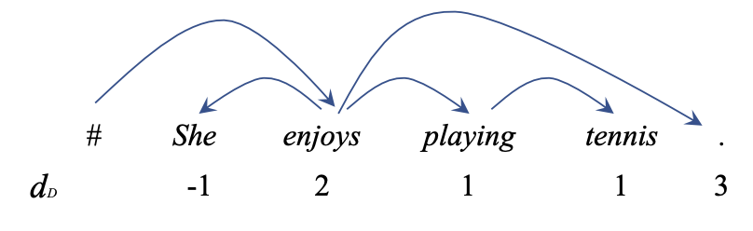
NMT with Syntactic Distance
Syntax distances
Constituency
d_{S}(w_{i}) is the height of the lowest common ancestor between w_{i} and w_{i+1}
d_{G}(w_{i}) is the number of common ancestors between w_{i} and w_{i+1}
d_{R}(w_{i}) = d_{G}(w_{i}) – d_{G}(w_{i-1}) if i > 1 else d_{G}(w_{i})
Dependency
d_{D}(w_{i}) = i – h(i)
h(i) is the index of the head of w_{i}
Integration
Input features
Positional encoding
Chunpeng Ma, et al., Improving Neural Machine Translation with Neural Syntactic Distance, 2019

Slide 27
Agenda
Linguistic features, tools and datasets
Augmented input feature NMT
Tree encoder
Syntax-aware representation
Syntax-aware self-attention

Slide 28
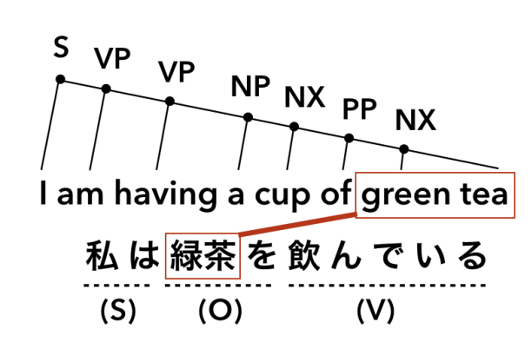
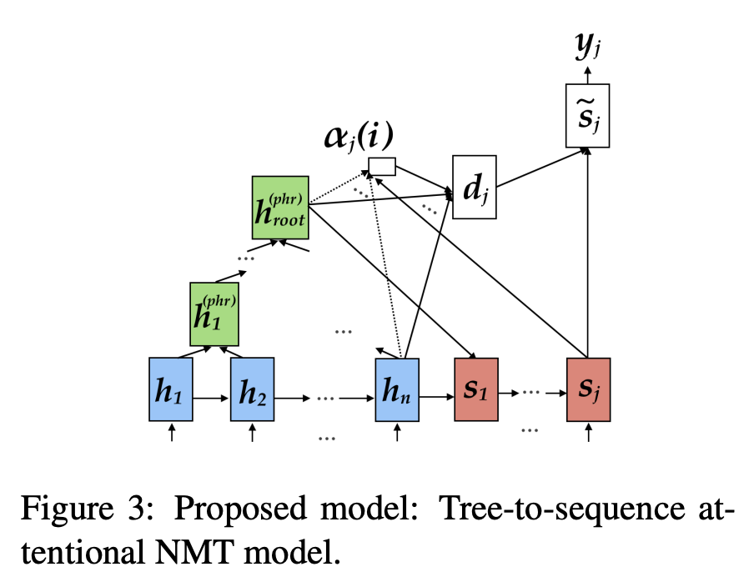
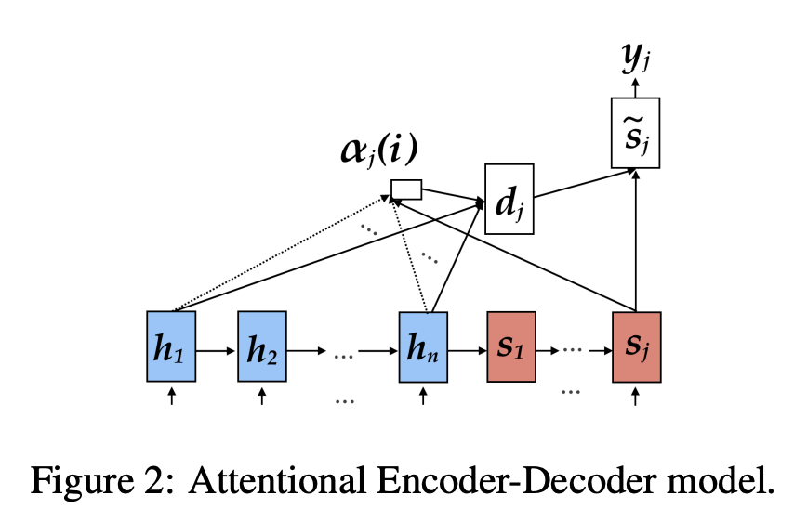
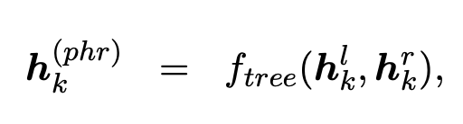
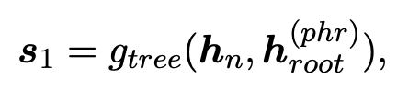
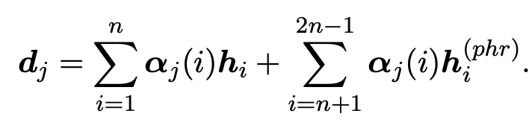
Tree Encoder
Linguistic distance languages
Different syntax construction
Different lexical units such as words/phrase
E.g., if ‘緑茶’ only align with ‘green’ and ‘tea’,
Then ‘a cup of’ will align with ‘null’.
Tree-LSTM
Context vector
Akiko Eriguchi, et al., Tree-to-Sequence Attentional Neural Machine Translation, 2016

Slide 29
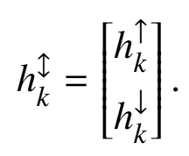
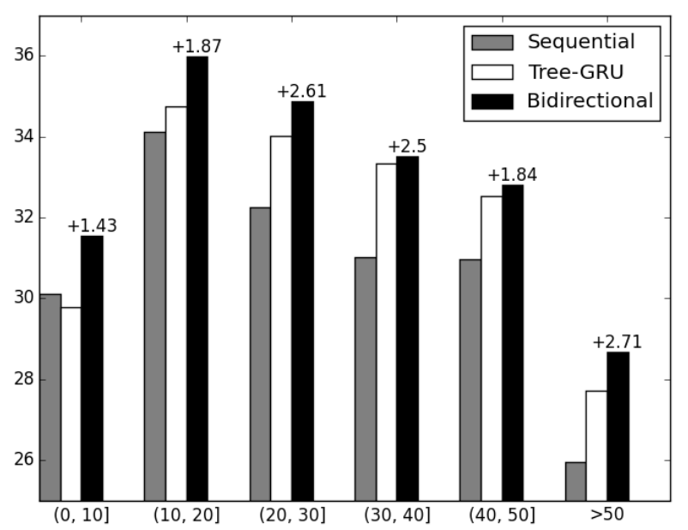
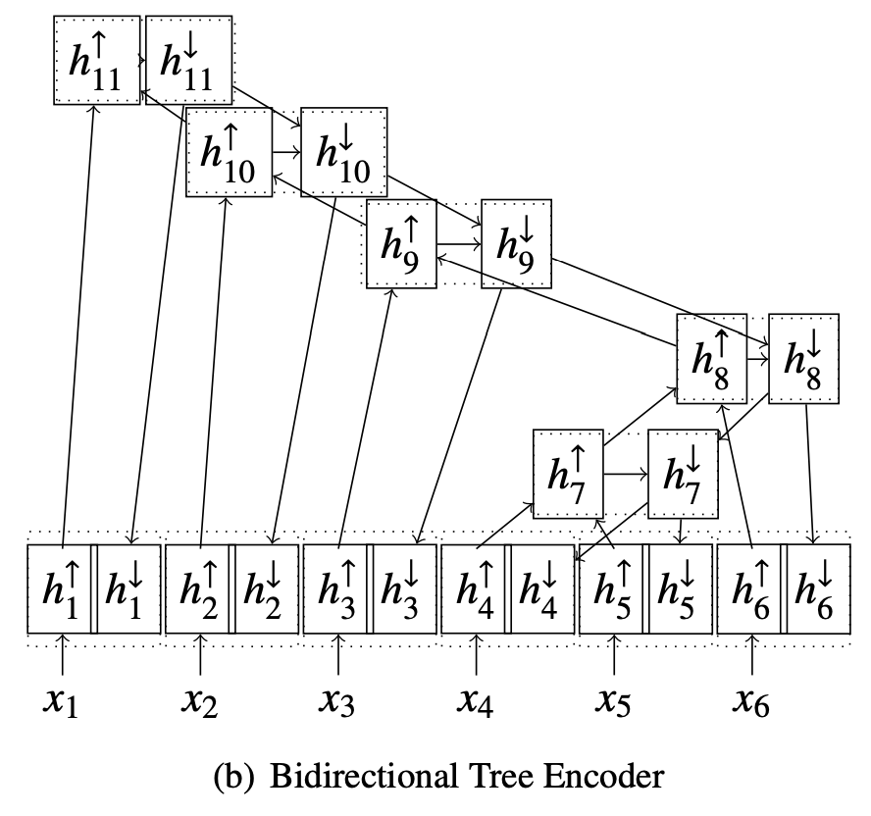
Bidirectional Tree Encoder
The node representation is based on its nodes only
And contains no information from the higher nodes
Tree-GRU
Huadong Chen, et al., Improved Neural Machine Translation with a Syntax-Aware Encoder and Decoder, 2017
Notes:
Downside of such networks
Dynamic networks
Difficult to batch sentences

Slide 30
Agenda
Linguistic features, tools and datasets
Augmented input feature NMT
Tree encoder
Syntax-aware representation
Syntax-aware self-attention

Slide 31
Syntax-aware representation
Generated linguistic features could be irrelevant or errors.
Linguistic features are always generated alongside the translation.
Implicit integration
Syntax-aware representation injection
Multi-task learning

Slide 32
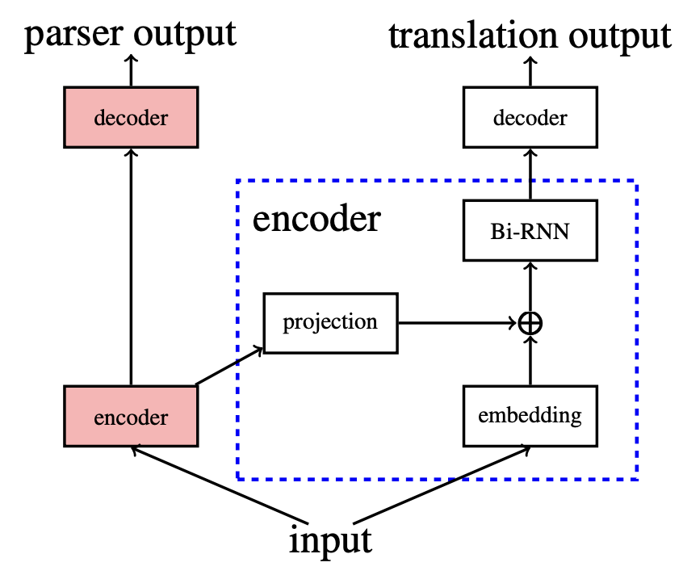
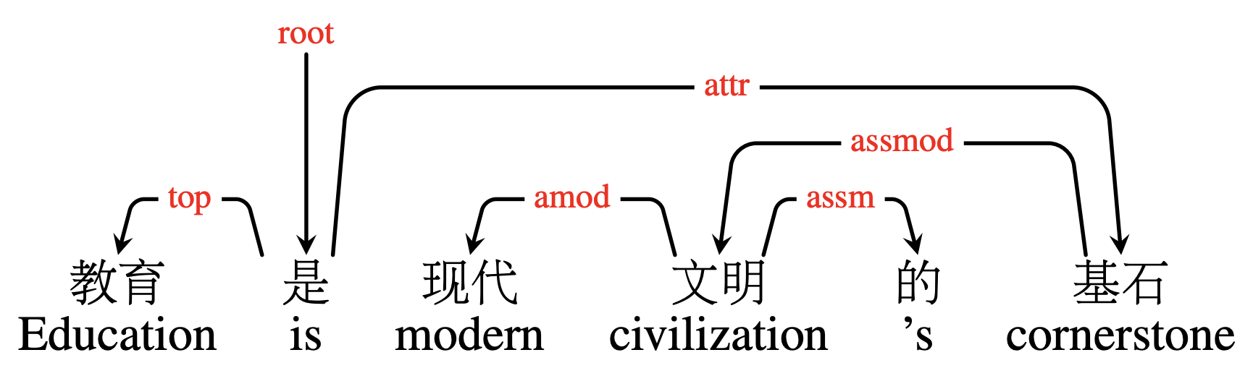
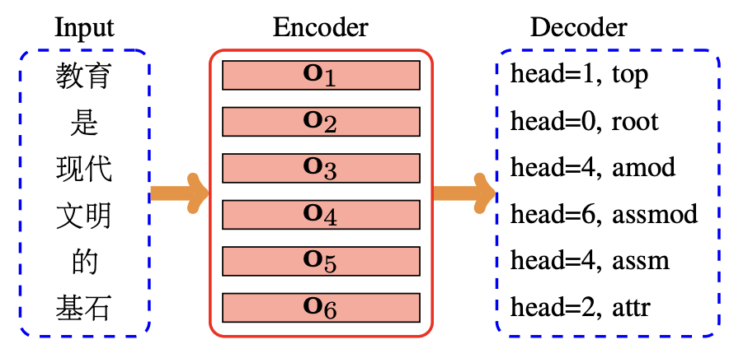
Syntax-Aware Representation Injection
First stage: pretrained linguistic model
Second stage: inject the linguistic encoder output into the input embedding
Meishan Zhang, et al., Syntax-Enhanced Neural Machine Translation with Syntax-Aware Word Representations, 2019

Slide 33
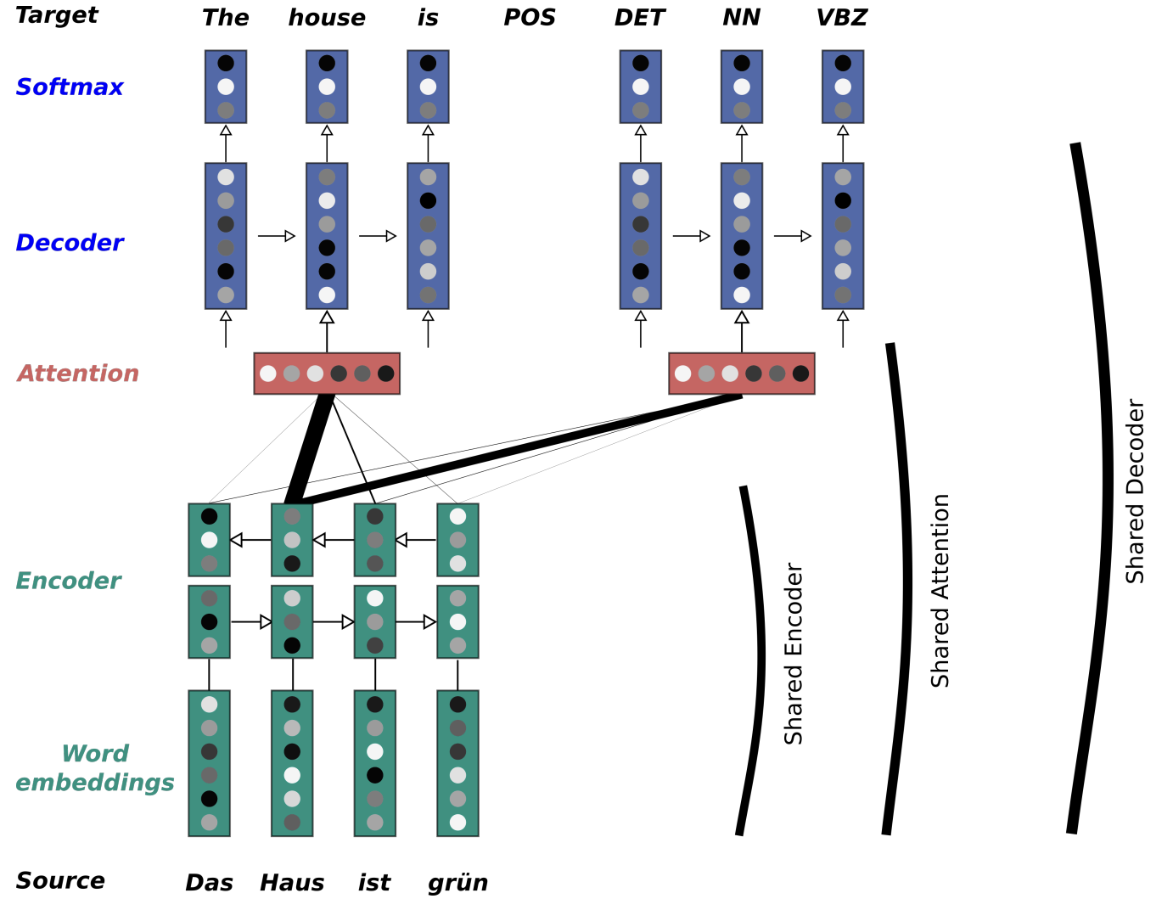
Multi-Task Learning
Training a model to perform two tasks jointly
Translation
Linguistic prediction
Task adaptation
Train on both tasks
Finetune on the main task
Jan Niehues, et al., Exploiting Linguistic Resources for Neural Machine Translation Using Multi-task Learning, 2017

Slide 34
Agenda
Linguistic features, tools and datasets
Augmented input feature NMT
Tree encoder
Syntax-aware representation
Syntax-aware self-attention

Slide 35
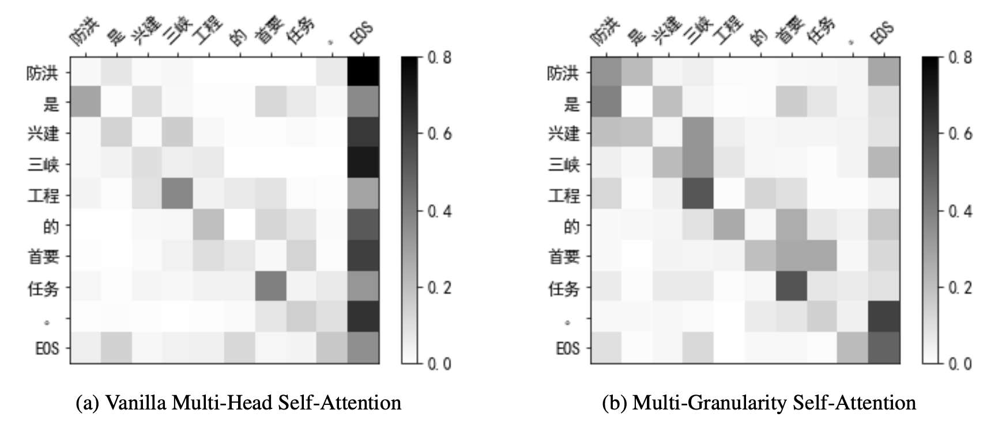
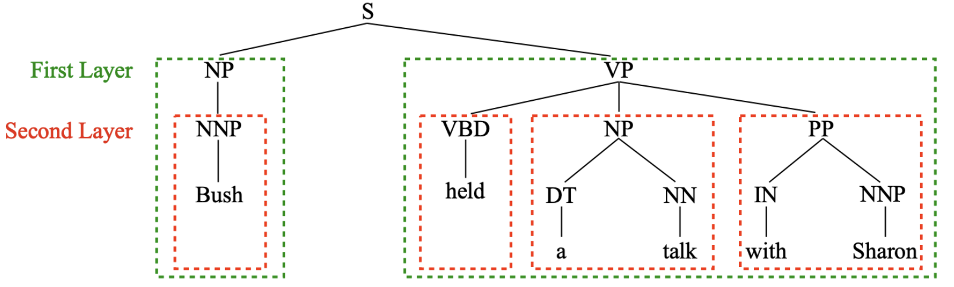
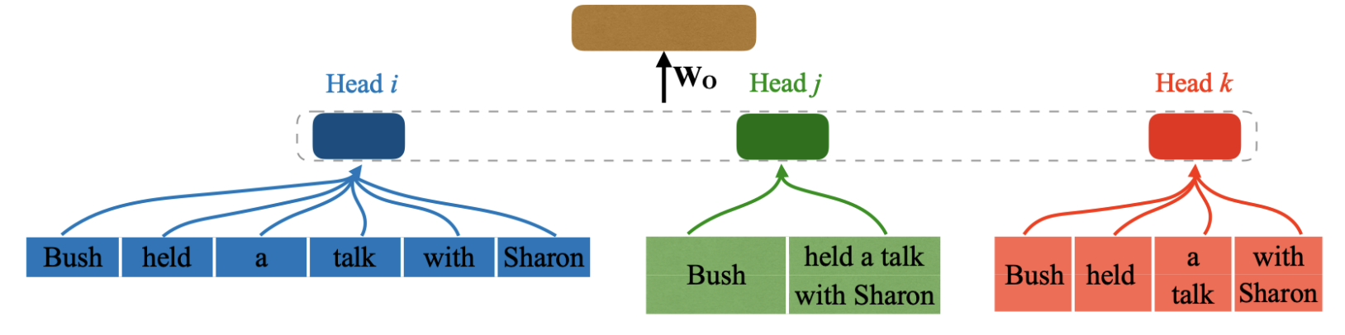
Multi-Granularity Self-Attention
3 steps
Phrase partition
N-gram or constituents
Phrase composition
CNN, RNN, or selft-attention network
Phrase interaction
LSTM or tree-like LSTM
Jie Hao, et al., Multi-Granularity Self-Attention for Neural Machine Translation, 2019

Slide 36
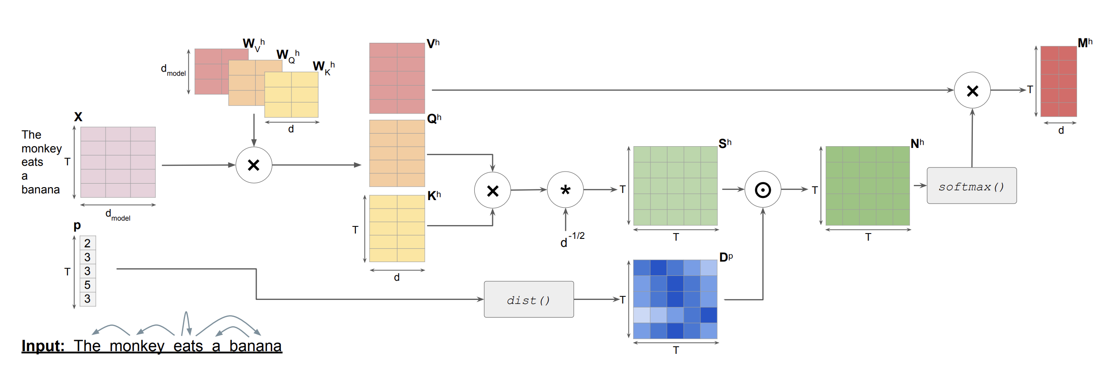
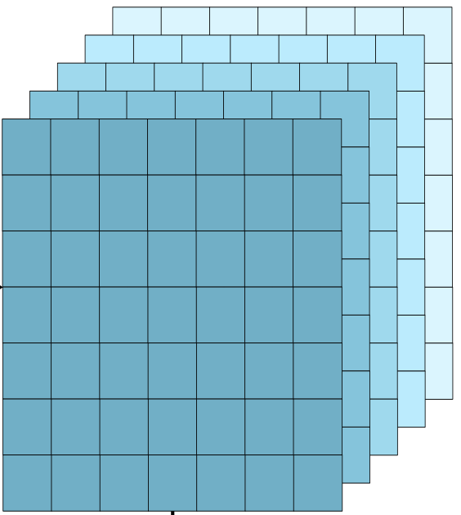
Dependency-Aware Self-Attention
Guide the attention weights using the dependency distance
Great improvement for long sentences
(1)
(2) Uncertainty
(1) Emanuele Bugliarello, et al., Enhancing Machine Translation with Dependency-Aware Self-Attention, 2020
(2) Dongqi Pu, et al., Passing Parser Uncertainty to the Transformer: Labeled Dependency Distributions for NMT, 2020

Slide 37

Summary
 | Augmented Input | Tree Encoder | Representation | Self Attention
Morphological features
Grammar relations
Linguistic features are usually useful for low-resource setting.
Grammar relation tend to beneficial long sentences.
However, the quality of the linguistic features is crucial.
This may hurt the translation performance
Soft/implicit integration such as data augment or representation learning, would reduce the constraint.

Slide 38
References
Abhisek Chakrabarty, et al., FeatureBART: Feature Based Sequence-to-Sequence Pre-Training for Low-Resource NMT, 2022
Abhisek Chakrabarty, et al., Improving Low-Resource NMT through Relevance Based Linguistic Features Incorporation, 2020
Abhisek Chakrabarty, et al., Low-resource Multilingual Neural Translation Using Linguistic Feature-based Relevance Mechanisms, 2023
Akiko Eriguchi, et al., Tree-to-Sequence Attentional Neural Machine Translation, 2016
Anna Currey, et al., Incorporating Source Syntax into Transformer-Based Neural Machine Translation, 2019
Anna Currey, et al., Multi-Source Syntactic Neural Machine Translation, 2018
Bei Li, et al., Does Multi-Encoder Help? A Case Study on Context-Aware Neural Machine Translation, 2020
Chunpeng Ma, et al., Improving Neural Machine Translation with Neural Syntactic Distance, 2019
Dongqi Pu, et al., Passing Parser Uncertainty to the Transformer: Labeled Dependency Distributions for NMT, 2020
Emanuele Bugliarello, et al., Enhancing Machine Translation with Dependency-Aware Self-Attention, 2020
Huadong Chen, et al., Improved Neural Machine Translation with a Syntax-Aware Encoder and Decoder, 2017
Jan Niehues, et al., Exploiting Linguistic Resources for Neural Machine Translation Using Multi-task Learning, 2017
Jie Hao, et al., Multi-Granularity Self-Attention for Neural Machine Translation, 2019
Jindřich Libovický, et al., Attention Strategies for Multi-Source Sequence-to-Sequence Learning, 2017
Junhui Li, et al., Modeling Source Syntax for Neural Machine Translation, 2017
Meishan Zhang, et al., Syntax-Enhanced Neural Machine Translation with Syntax-Aware Word Representations, 2019
Rico Sennrich et al., Linguistic Input Features Improve Neural Machine Translation, 2016

Slide 39
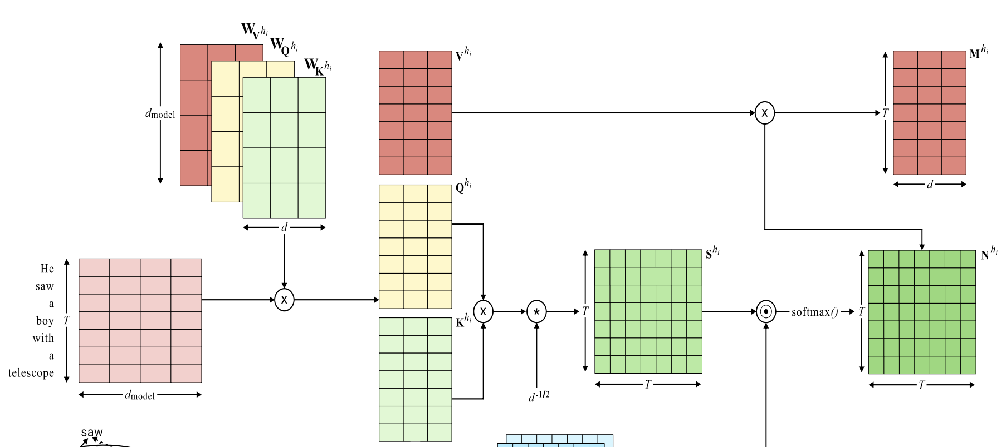
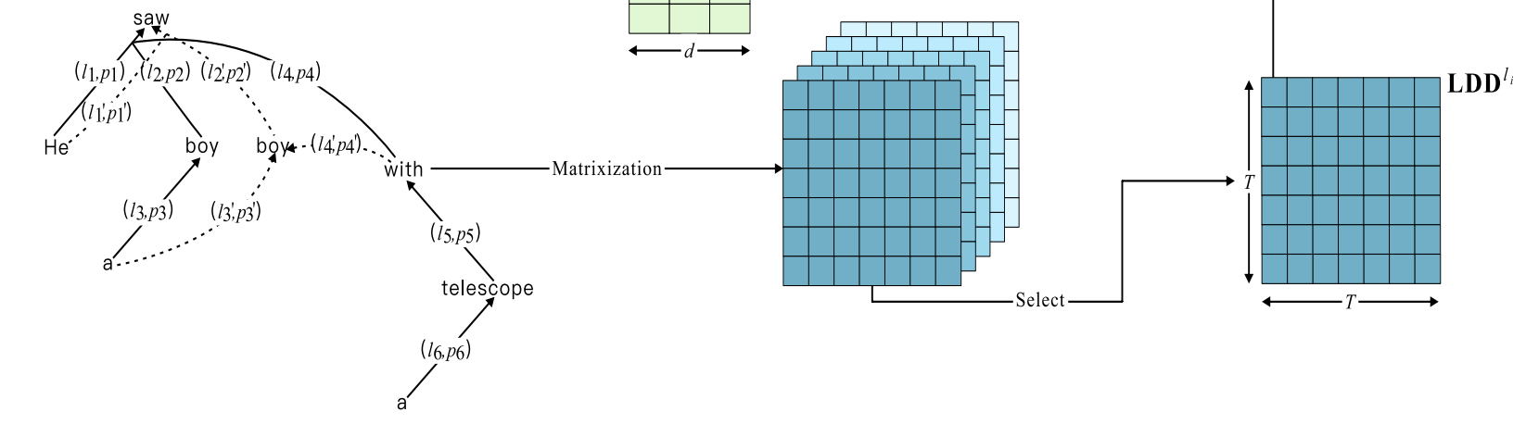
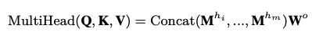
Parser Uncertainty into Self-Attention
Syntax ambiguity and parser uncertainty
E.g., He saw a boy with a telescope
Soft syntactic guidance to the attention weights
Give model flexibility to select useful dependencies
Label type
Forest
Dongqi Pu, et al., Passing Parser Uncertainty to the Transformer: Labeled Dependency Distributions for NMT, 2020

Slide 40
Multiple Encoders
y_{t-1}
y_{t}
S_{t-1}
S_{t-1}
Attentional RNN NMT
Context vector concatenation
Joint attention distribution
Hierarchical Attention Combination
c_{t}
+
Simplify
c_{t}
+
RNN
⍺_{t,1}
⍺_{t,2}
⍺_{t,T}
…
RNN Encoder
x
[c_{t}¹, c_{t}²]
+
x₁
x₂
x_{T}
+
+
+
+
+
Attentional RNN
Encoder-Decoder
RNN
RNN
RNN
RNN
RNN
RNN
x
f
x
f
x
f
Context concat.
Joint attention
Hierarchical attention
Jindřich Libovický, et al., Attention Strategies for Multi-Source Sequence-to-Sequence Learning, 2017
Notes:
Concatenate the context vector after the weighted sum
2. Joint attention or flat attention combination regard both sequences as a single sequence and perform weighted sum.
3. Weight sum over the context vector

Slide 41
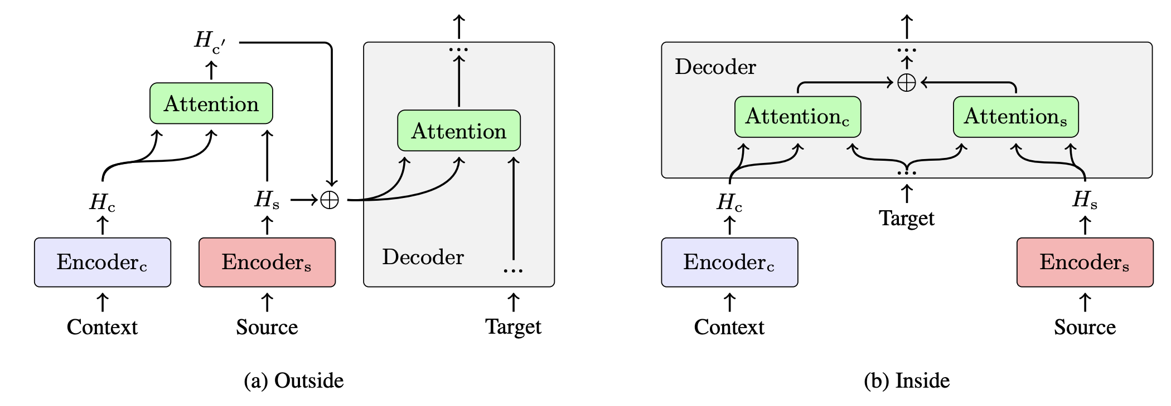
Multiple Encoders
How about multiple encoder in transformer NMT?
Considering parse as context
Inside and outside integration
Bei Li, et al., Does Multi-Encoder Help? A Case Study on Context-Aware Neural Machine Translation, 2020
Notes:
the representations of the context and the current sentence are firstly transformed into a new representation by an attention network. Then the attention output and the source sentence representation are fused by a gated sum.
the decoder can attend to two encoders respectively. Then, the gating mechanism inside the decoder is employed to obtain the fusion vector.

